Slide 1

Regression Project (Machine Learning)
Presented By
Student Name: Fareesa Hibah
College Name: NSTI - R
Department: Artificial Intelligence
Email ID: hibahrosary@gmail.com
AICTE Student ID: STU67852ad46b3a21736780500

Slide 2
OUTLINE
Problem Statement
Proposed System/Solution
System Development Approach
Algorithm & Deployment
Result (Output Image)
Conclusion
Future Scope
References

Slide 3
Problem Statement
Currently, vehicle CO2 emissions are a major concern in the automotive industry as environmental regulations become stricter. It is important to accurately predict emissions based on vehicle characteristics, as it helps manufacturers optimize designs and meet standards. Eventually, developing environmentally friendly vehicles becomes a major priority. The crucial part is the prediction of CO2 emissions for each vehicle type to ensure compliance with regulations and support sustainable transportation.

Slide 4
Proposed Solution
The system predicts vehicle CO2 emissions using machine learning and data analytics to analyze vehicle characteristics, supporting environmental regulations and optimizing design decisions for automotive manufacturers.
Data Collection:
Gather comprehensive vehicle data, including engine specifications, fuel type, transmission, and other relevant characteristics.
Utilize manufacturer specifications, emission test results, and real-world performance data to enhance prediction accuracy
Data Preprocessing:
Clean and preprocess the collected data to handle missing values, outliers, and inconsistencies.
Feature engineering to extract relevant features from vehicle specifications that might impact CO2 emissions.
Machine Learning Algorithm:
Implement regression algorithms (e.g., Linear Regression, Random Forest, or XGBoost) to predict CO2 emissions based on vehicle characteristics.
Consider incorporating interaction effects between features like engine size, fuel type, and vehicle class to improve prediction accuracy.

Slide 5
Proposed Solution
Deployment:
Develop an interactive dashboard that provides emission predictions for different vehicle configurations.
Deploy the solution with visualization tools to help stakeholders understand feature importance and emission patterns.
Evaluation:
Assess the model's performance using appropriate metrics such as Mean Absolute Error (MAE), Root Mean Squared Error (RMSE), or other relevant metrics.
Fine-tune the model based on feedback and continuous monitoring of prediction accuracy.
Expected Results:
Accurate prediction of CO2 emissions for new vehicle configurations.
Insights into which vehicle characteristics most significantly impact emissions.
Recommendations for optimal vehicle configurations to minimize emissions.

Slide 6
System Approach
System requirements:
Hardware Requirements
Computer with sufficient processing power for data analysis.
Adequate RAM for handling large datasets.
Storage space for dataset and model files.
Software Requirements
Python 3.x as the primary programming language.
Jupyter Notebook/VS Code for development and visualization.
Operating System: Windows/Linux/MacOS
Data Requirements
Access to CO2 emissions dataset.
Vehicle specifications data.
Clean and structured data format.

Slide 7
System Approach
Libraries required to build the model:
Data Manipulation and Analysis
Pandas: For data preprocessing and manipulation
NumPy: For numerical operations
Data Visualization
Matplotlib: For basic data visualization.
Seaborn: For statistical visualizations
Machine Learning
Scikit-learn: For model selection

Slide 8
Algorithm
Algorithm Selection:
We use Linear Regression to predict CO2 emissions due to its ability to capture linear relationships between vehicle features and emissions, while providing clear insights into feature importance.
Data Input: The algorithm utilizes the following input features:
Engine Size (L): Continuous variable representing engine capacity
Fuel Consumption Metrics: City (L/100 km), Highway (L/100 km), Combined (L/100 km)
Number of Cylinders: Integer value
Vehicle Class, Transmission Type, Fuel Type: Categorical variable
Training Process: The model training follows these steps:
Data preprocessing:
Encoding categorical variables (Vehicle Class, Transmission, Fuel Type)
Normalizing numerical features
Splitting data into training (80%) and testing (20%) sets

Slide 9
Algorithm
Model fitting:
Training the Linear Regression model on preprocessed data
Using k-fold cross-validation to ensure model stability
Evaluating model performance using R-squared and RMSE metrics
Prediction Process: The trained model makes predictions through:
Input processing:
Applying the same preprocessing steps used in training
Normalizing new vehicle data
Prediction generation:
Calculating predicted CO2 emissions in g/km
Providing confidence intervals for predictions
Identifying key features influencing the prediction

Slide 10
DEPLOYMENT
System Requirements
Hardware:
Standard CPU-based system (no GPU required)
Minimum 8GB RAM
50GB storage for data and model
Software:
Python 3.8+
Key libraries:
pandas for data manipulation
numpy for numerical operations
scikit-learn for model implementation
matplotlib for visualization
Implementation Process
Model Deployment:
Saving trained model using pickle/joblib
Creating a prediction pipeline
Setting up error handling and validation

Slide 11
DEPLOYMENT
User Interface:
Simple web form for input
Results display with visualizations
Export functionality for predictions
Maintenance
Regular Updates:
Monthly model retraining with new data
Performance monitoring
Data validation checks
Documentation:
User manual
Technical documentation
Troubleshooting guide

Slide 12
Result
The Linear Regression model's performance in predicting vehicle CO2 emissions shows promising results:
Performance Metrics
R-squared Score : 0.868 (86.8%)
Indicates that approximately 87% of the variance in CO2 emissions is explained by the model
Shows strong predictive capability
Mean Absolute Error (MAE) : 14.14 g/km
On average, predictions deviate by about 14 grams of CO2 per kilometer
Relatively small considering the range of CO2 emissions (96-522 g/km)
Mean Squared Error (MSE) : 454.44
Higher MSE indicates the presence of some larger prediction errors
Square root (RMSE) would be approximately 21.32 g/km
Context of Results
These results should be interpreted in the context of the dataset's characteristics:
Total range of CO2 emissions: 96 to 522 g/km
Mean CO2 emission: ~250.58 g/km
Standard deviation: ~58.51 g/km
The model's error metrics (MAE of 14.14 g/km) represent about 5.6% of the mean CO2 emission value, indicating good predictive accuracy for practical applications.

Slide 13
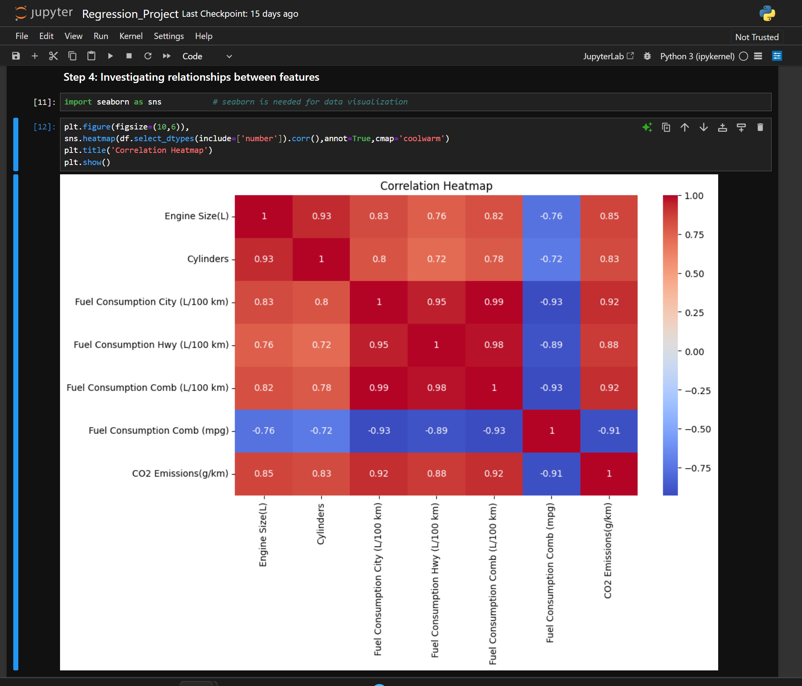
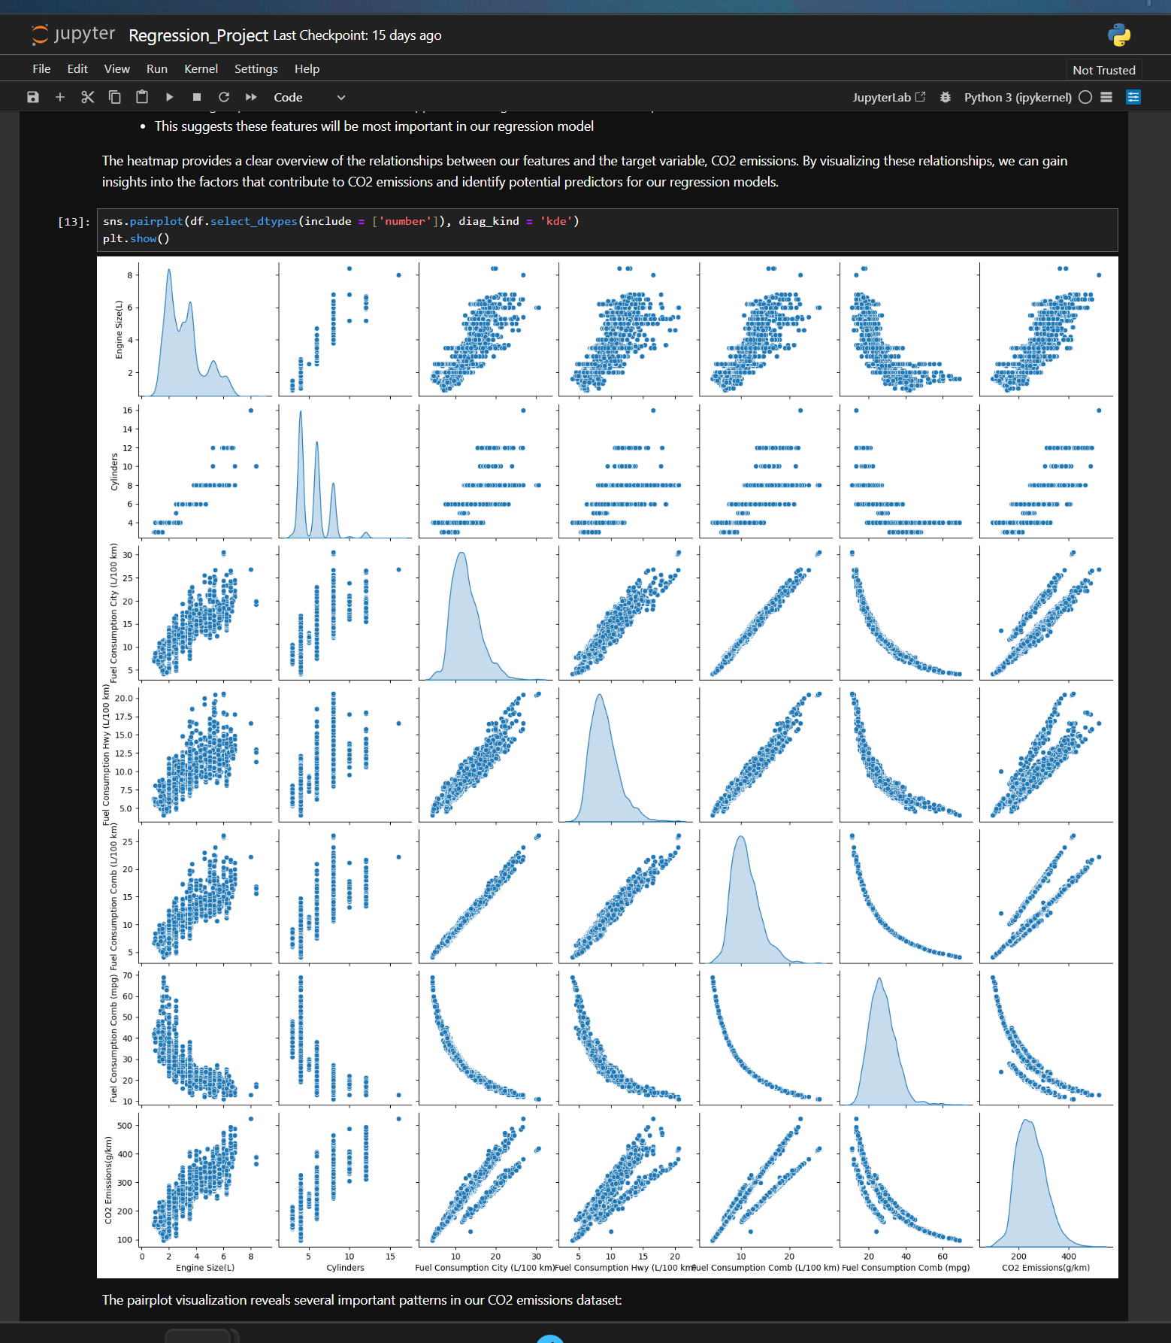
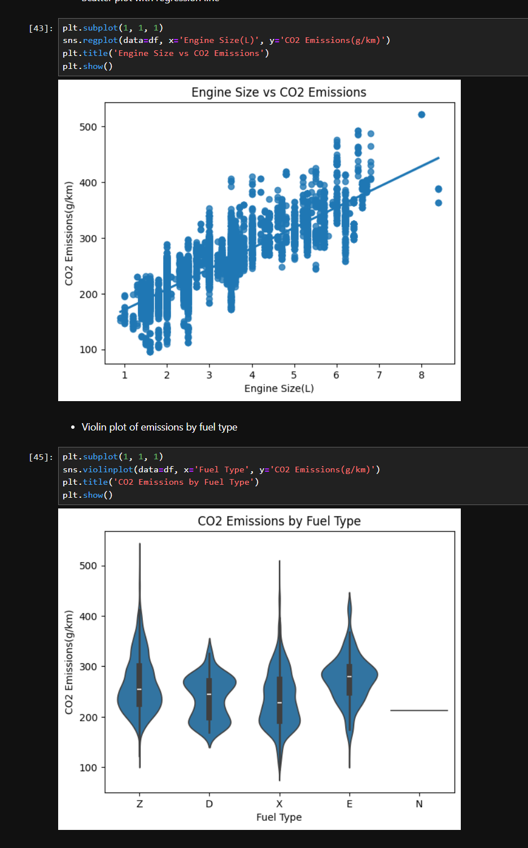
Result

Slide 14
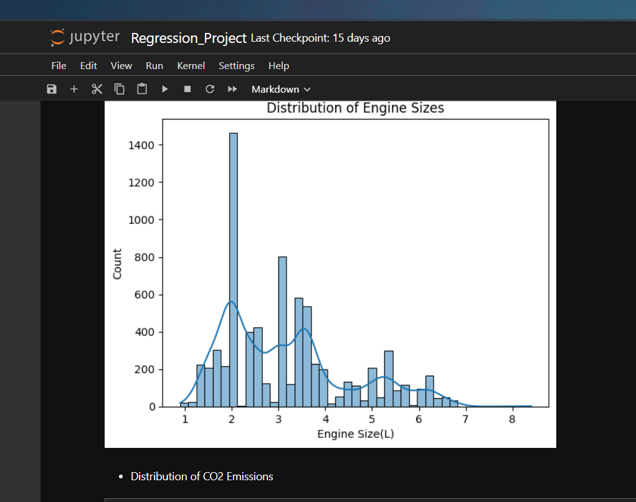

Result

Slide 15
Conclusion
The Linear Regression model successfully predicts vehicle CO2 emissions with 87% accuracy (R-squared: 0.868). The model achieves a Mean Absolute Error of 14.14 g/km, representing about 5.6% of mean emissions, demonstrating strong practical utility.
Core Achievements
Effective prediction using engine size and fuel consumption metrics
Clean, complete dataset requiring minimal preprocessing
Reliable predictions for automotive industry applications
Future Opportunities
Implement advanced algorithms (Random Forest, XGBoost)
Add more features and non-linear relationships
Expand model capabilities with cross-validation
The project provides valuable insights for vehicle manufacturers, consumers, and environmental policymakers, with clear paths for future enhancement.

Slide 16
Future scope
Core Enhancements
Implement advanced algorithms (Random Forest, Deep Learning)
Add real-time data processing capabilities
Integrate environmental and driving condition data
System Expansion
Cloud-based processing and API development
Mobile app for real-time monitoring
Interactive dashboard for analytics
Industry Impact
Support manufacturer design optimization
Aid environmental policy decisions
Enable emission compliance monitoring
These improvements will transform the current model into a comprehensive emissions management system.

Slide 17
References
The dataset for this project was sourced from Kaggle's CO2 Emissions dataset, complemented by comprehensive course notes from college coursework on regression analysis and environmental data modeling. This combination of real-world data and academic knowledge provides a solid foundation for understanding and predicting vehicle CO2 emissions.
Dataset was taken from: CO2 - Emissions
GitHub Link: Link

Slide 18
Thank you

